Slide 1
Non-destructive test methods in HV engineering
Partial discharges in PWM-inverter
fed low-voltage Induction motors
M.Sc., Associate Professor Claus Leth Bak
Institute of Energy Technology, Aalborg University

Slide 2
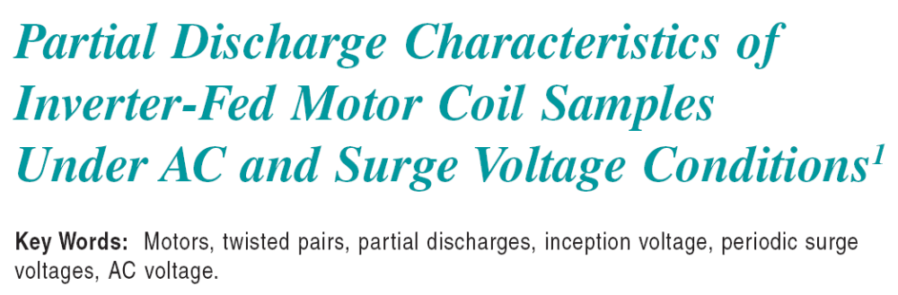

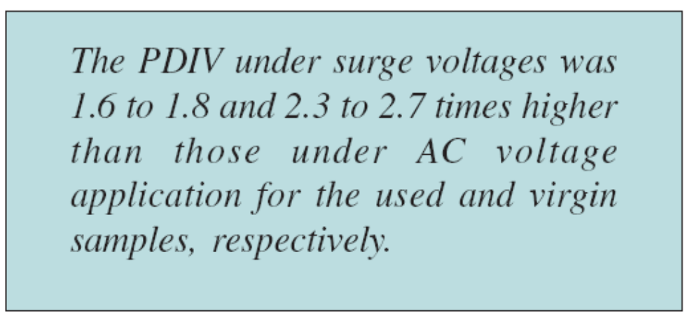
Non-destructive test methods in HV engineering

Slide 3
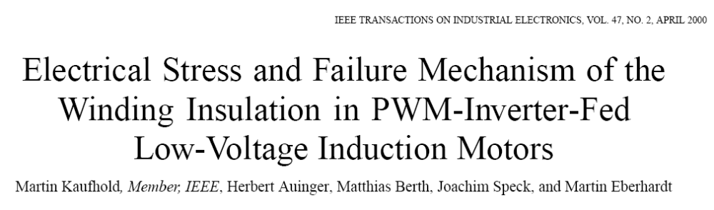
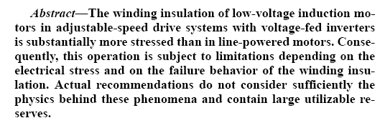
Non-destructive test methods in HV engineering

Slide 4
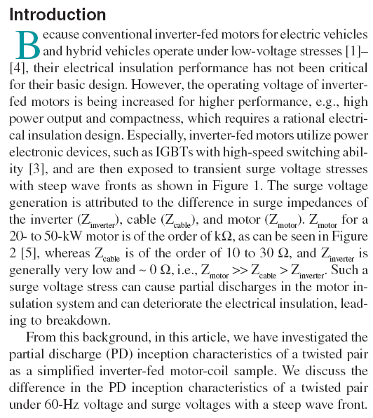
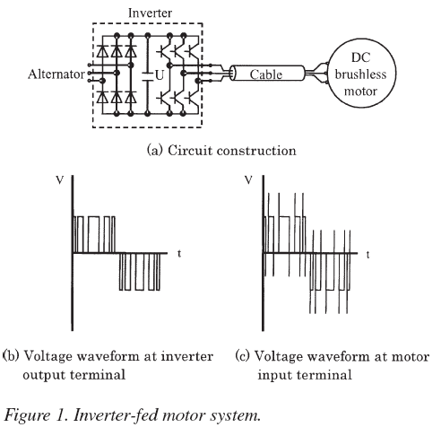
Non-destructive test methods in HV engineering

Slide 5
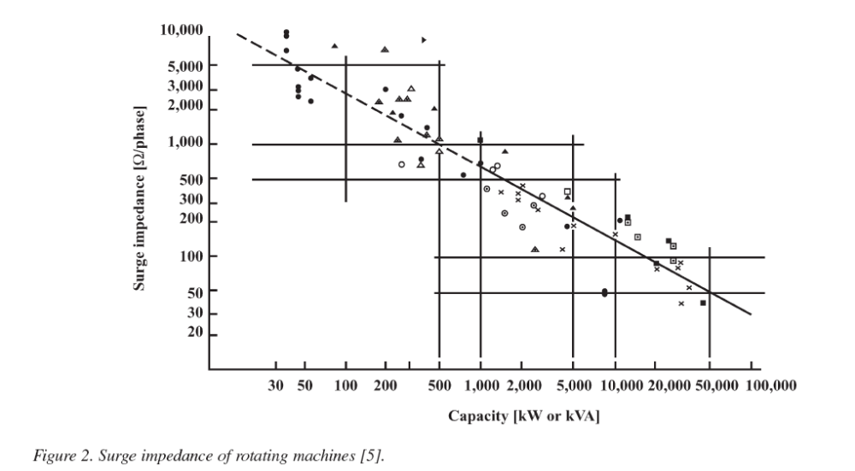
Non-destructive test methods in HV engineering

Slide 6
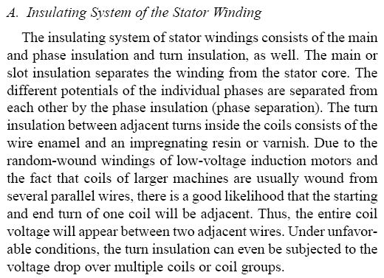

Non-destructive test methods in HV engineering

Slide 7
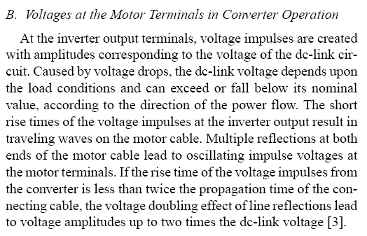
Non-destructive test methods in HV engineering

Slide 8
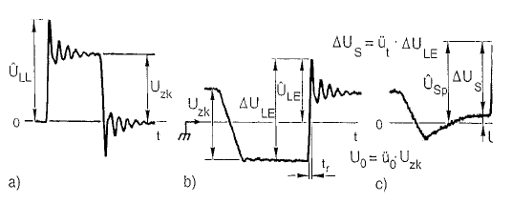
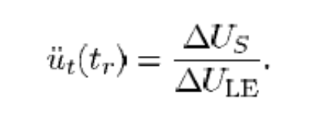
Non-destructive test methods in HV engineering
Voltage crossing
first coil
Line – Line Voltage
Line – ground
voltage
Phase insulation
stress!!
Main insulation
(slot) stress!!
Voltage step on line-end
coil ΔU_{S}

Slide 9
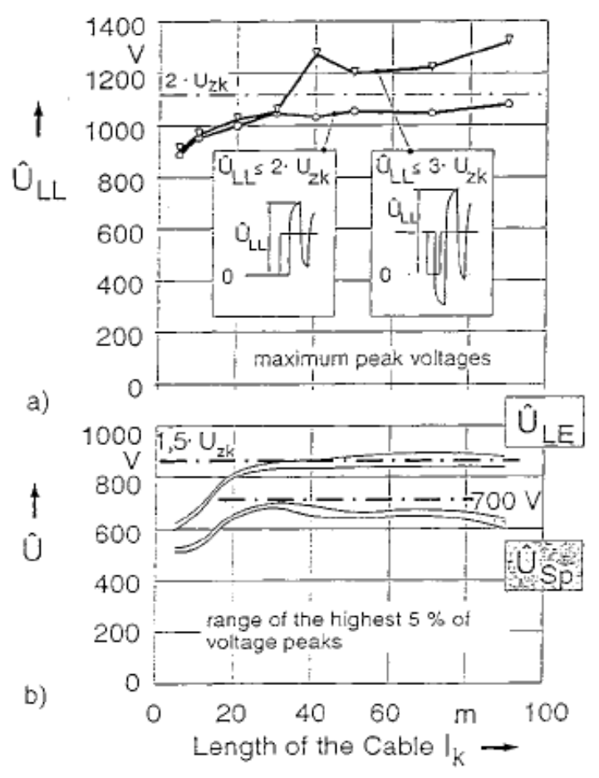
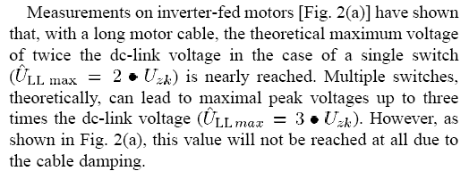
Non-destructive test methods in HV engineering

Slide 10
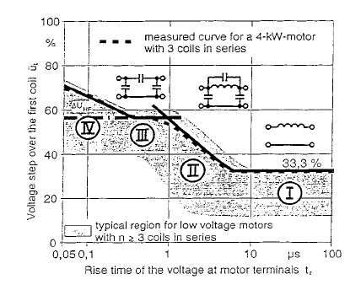
Non-destructive test methods in HV engineering
Transient voltage steps distribute unevenly over the coils of the
winding. This is controlled by rise time and inductive/capacitive
coupling in winding. We DEFINE ratio ü_{t} = ΔU_{S}/ ΔU_{LE}
Range I: Inductive couplings only, even
voltage distribution.
Range II: Inductive/capacitive elements
produce behavior like transmission line.
Range III: Mainly capacitive couplings.
For rise time for PWM inverters with
t_{R} app. 200 ns – 1000 ns.
Range IV: Shorter rise times 50 – 200 ns
gives HF oscillations. Only for very short
motor cables!!

Slide 11
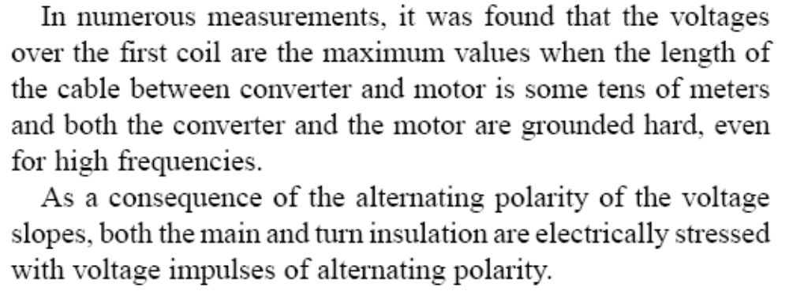
Non-destructive test methods in HV engineering

Slide 12
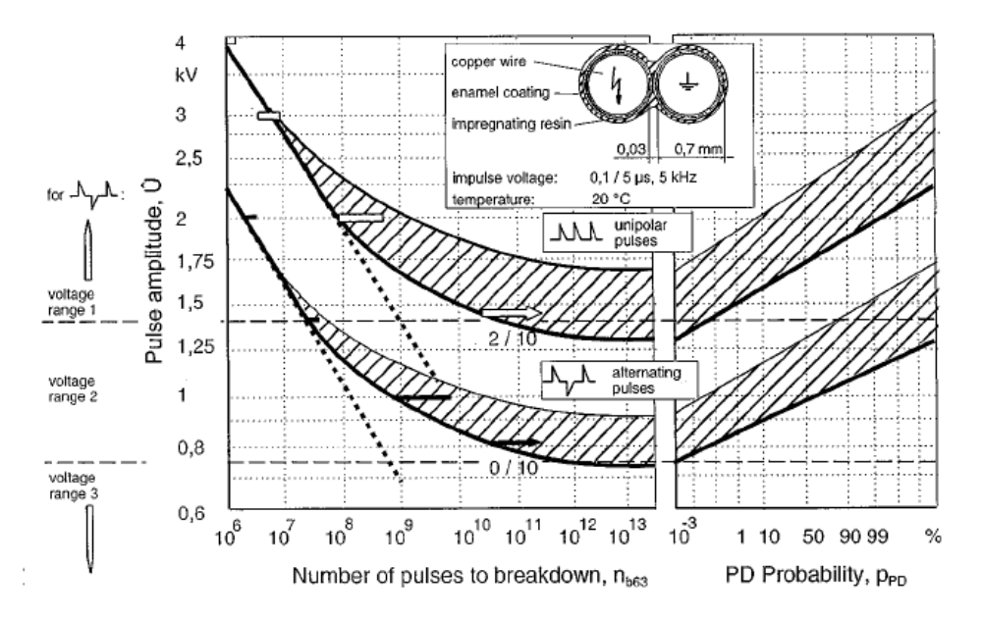
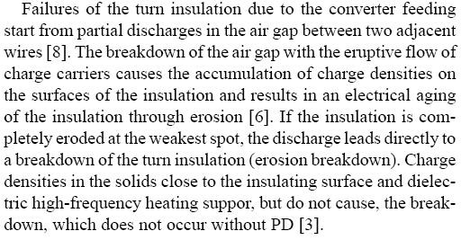
Non-destructive test methods in HV engineering
Range I: All impulses leads
to breakdown.
U_{b}=18*n_{b}^{1/6,5} EMPIRIC
Range II: Not all impulses
gives breakdown – probability
based approach.
Range III: No PD
CONCLUSION

Slide 13
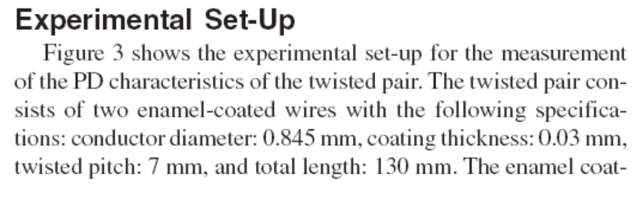
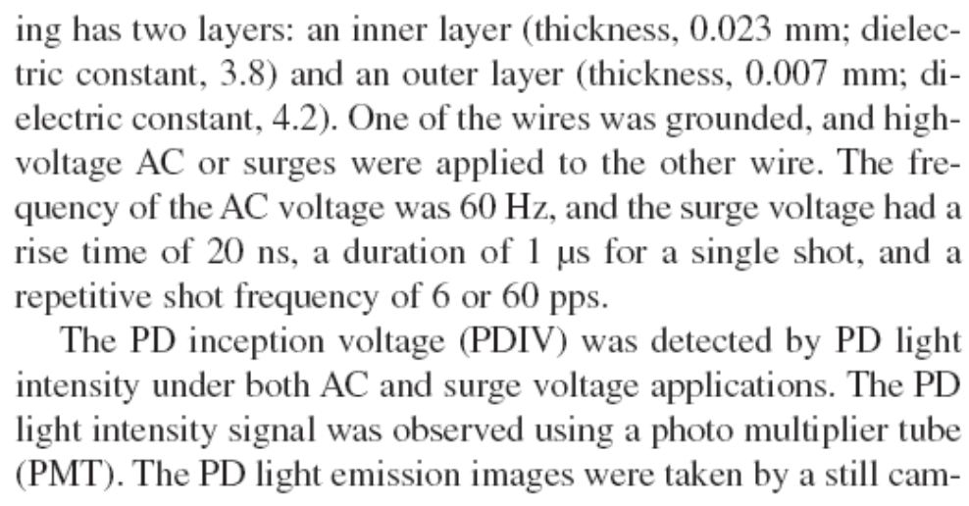
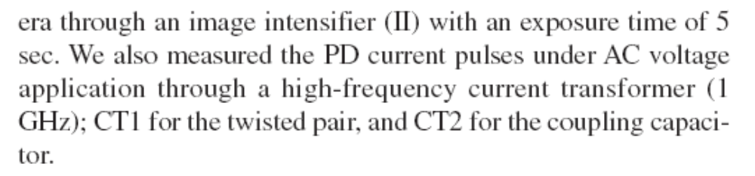
Non-destructive test methods in HV engineering

Slide 14
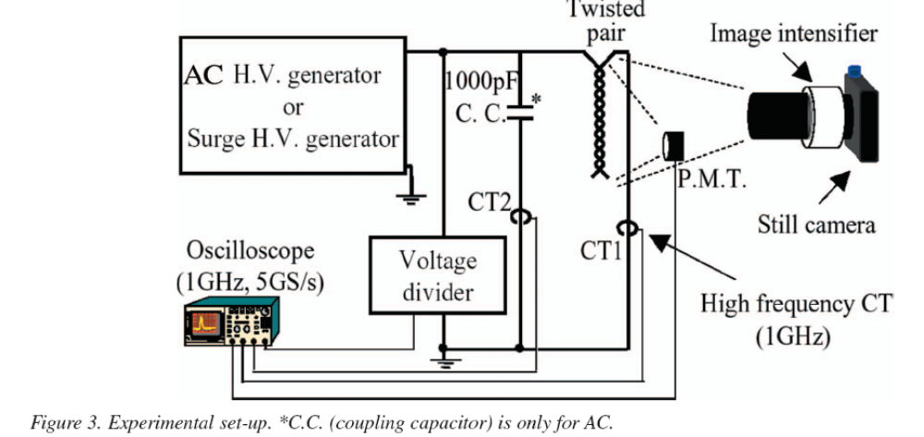
Non-destructive test methods in HV engineering

Slide 15
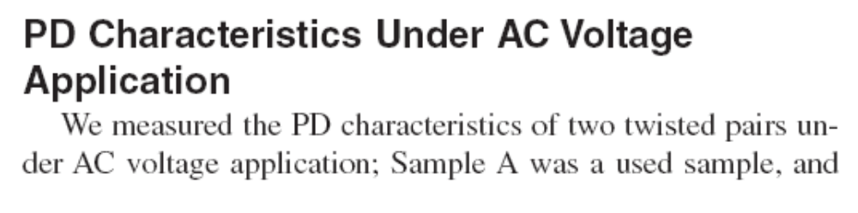
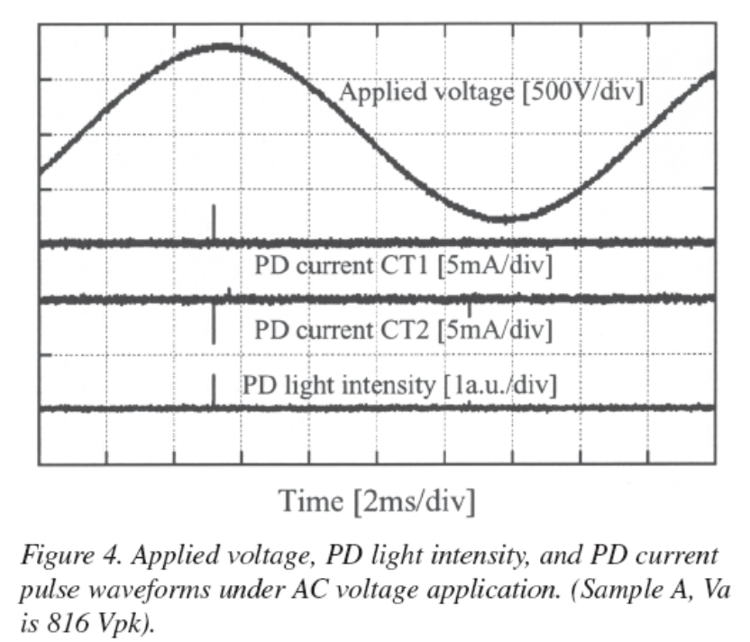
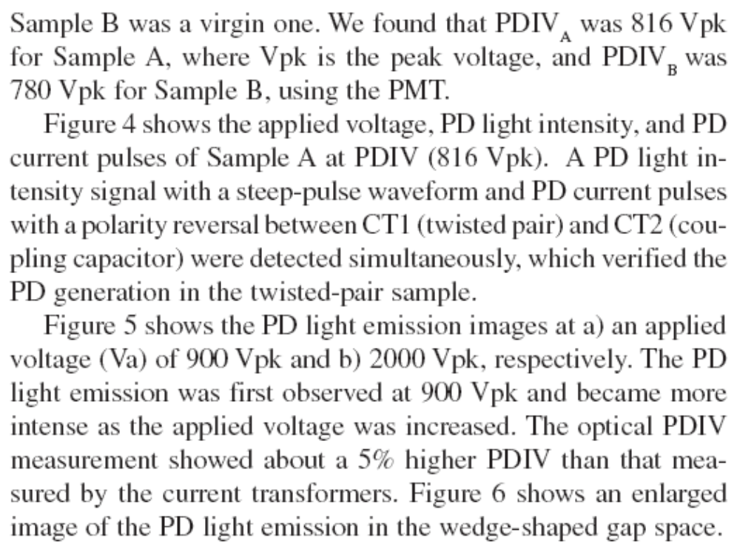
Non-destructive test methods in HV engineering

Slide 16
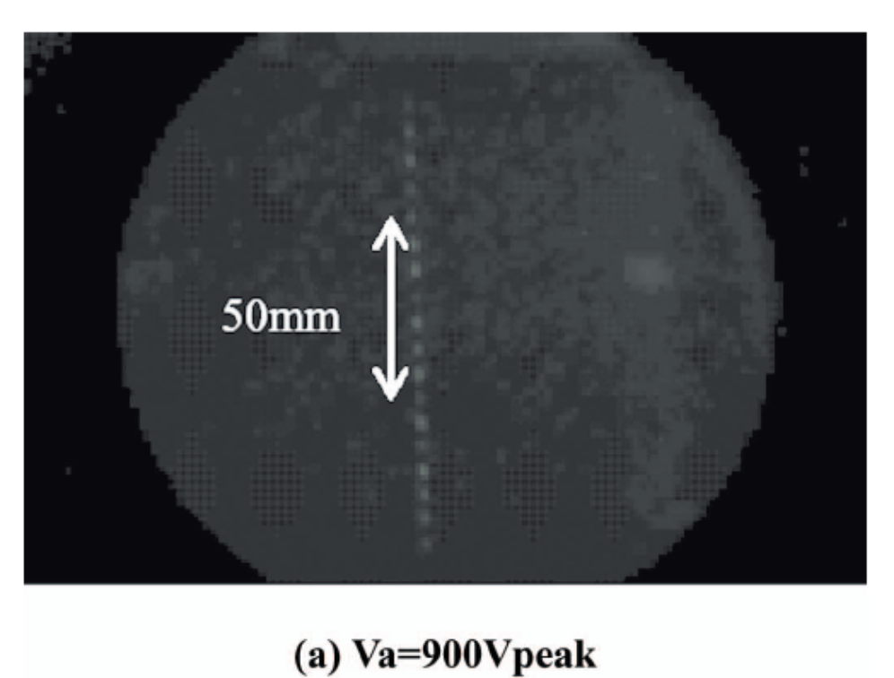
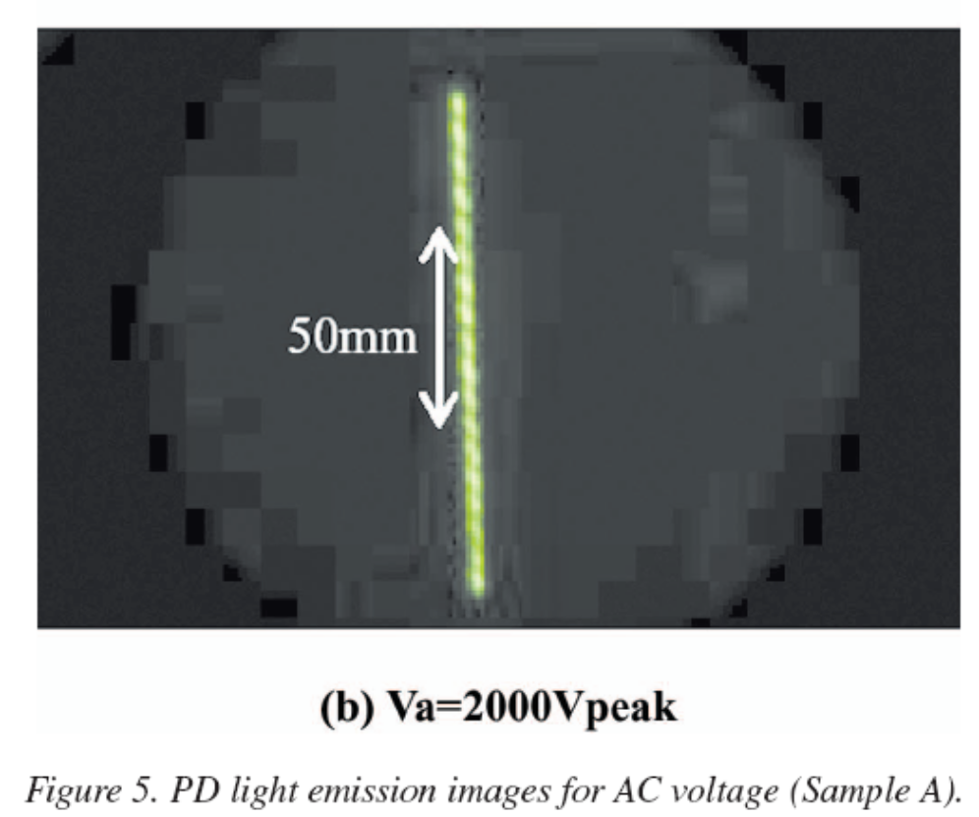
Non-destructive test methods in HV engineering

Slide 17
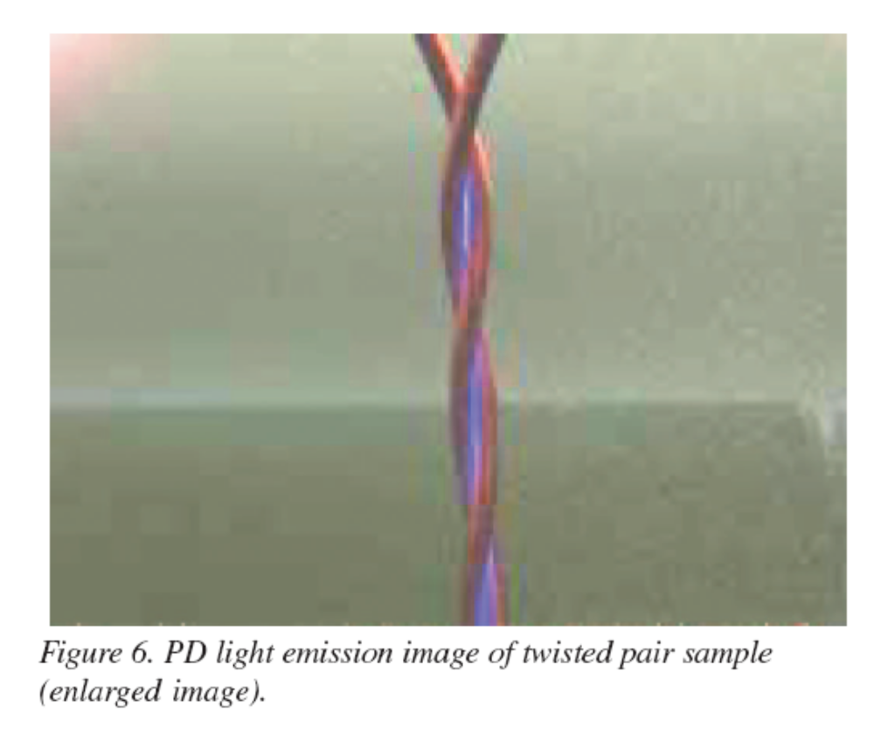
Non-destructive test methods in HV engineering

Slide 18
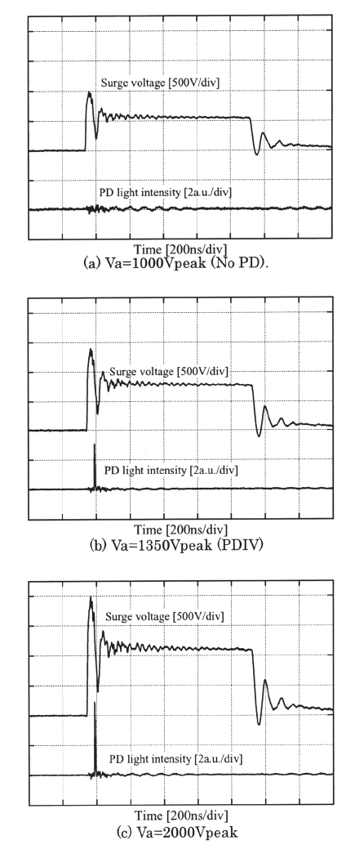
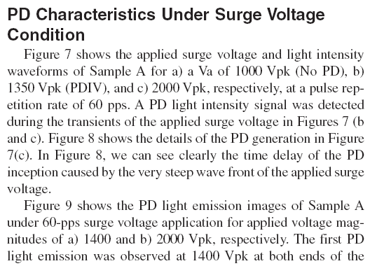
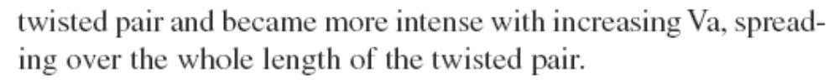
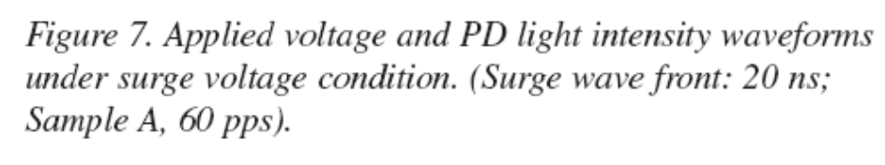
Non-destructive test methods in HV engineering

Slide 19
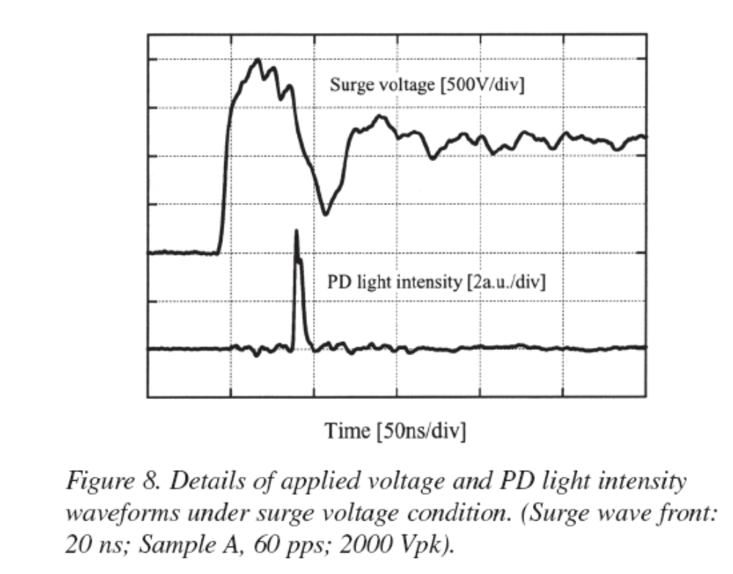
Non-destructive test methods in HV engineering

Slide 20
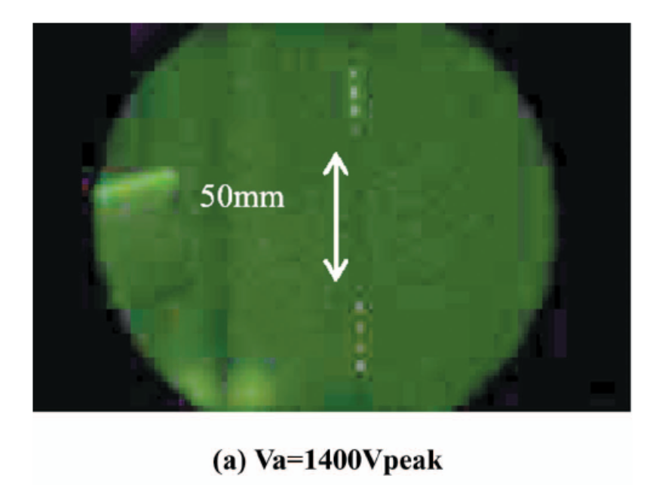
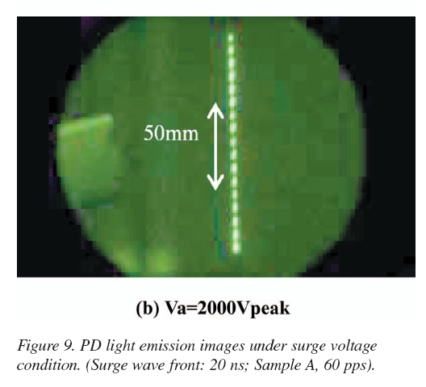
Non-destructive test methods in HV engineering

Slide 21
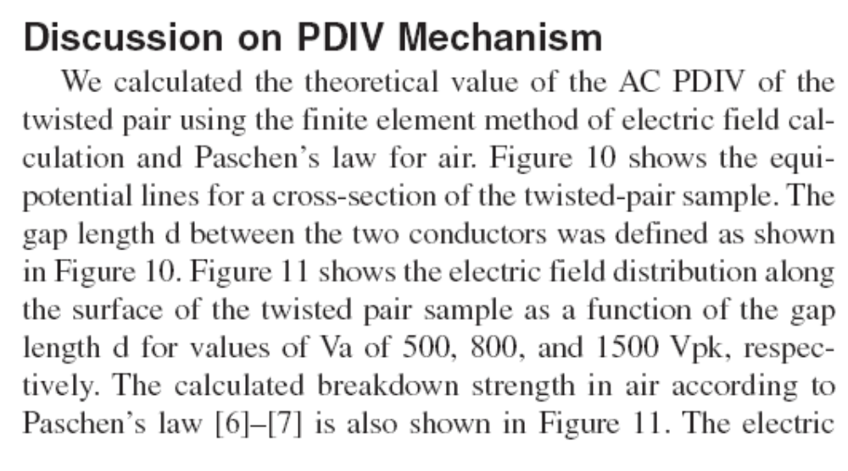
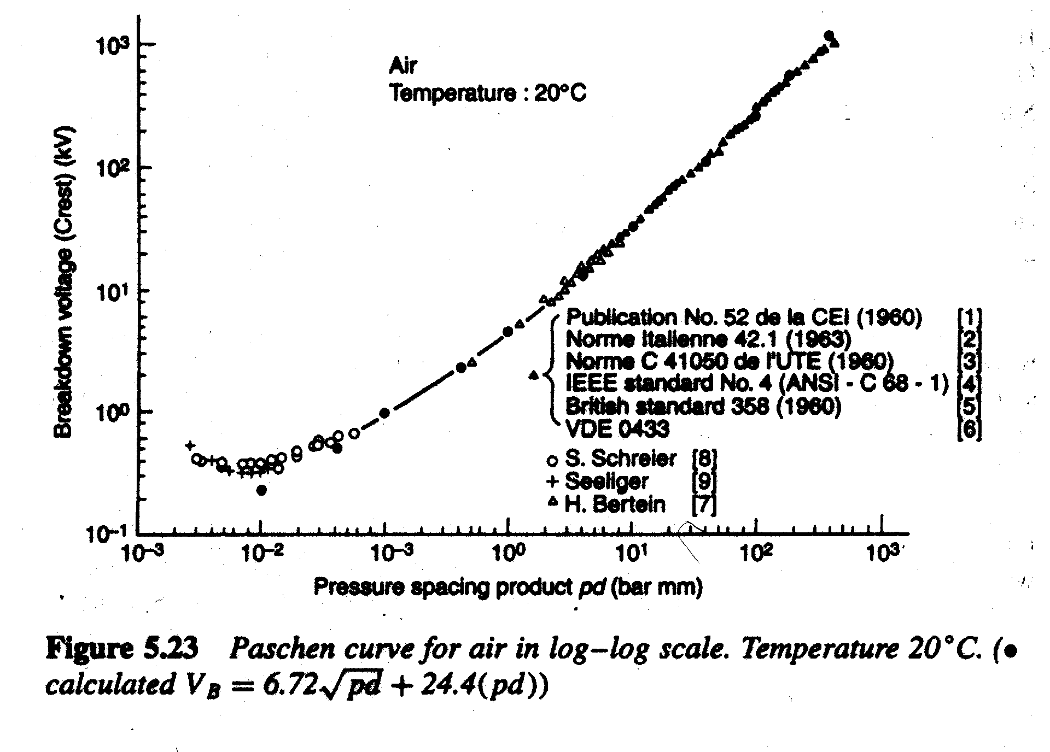
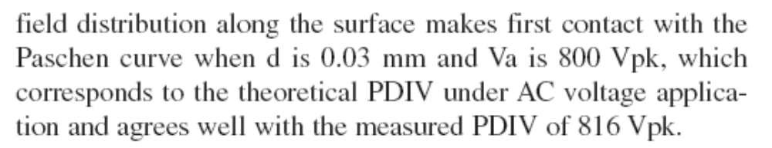
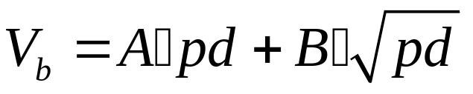
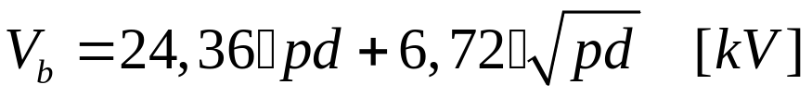
Non-destructive test methods in HV engineering

Slide 22
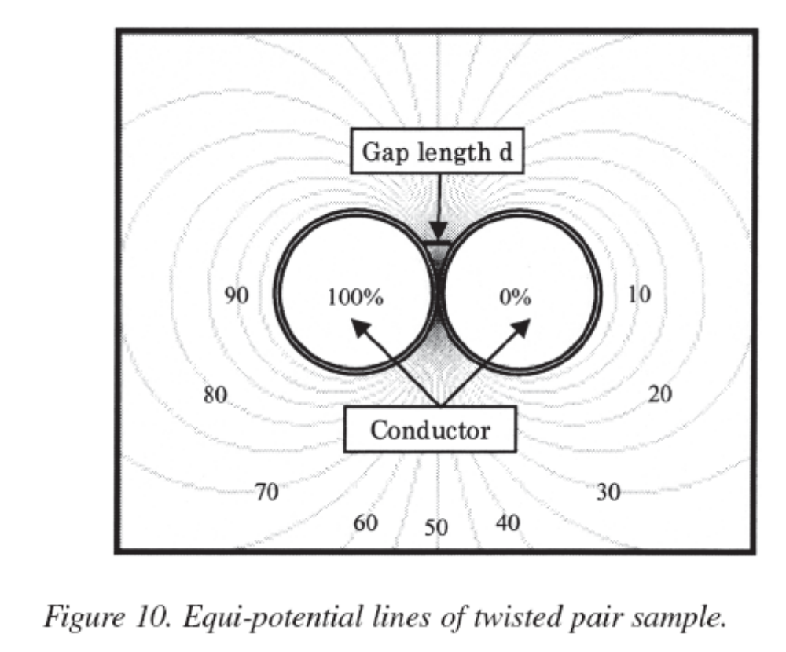
Non-destructive test methods in HV engineering

Slide 23
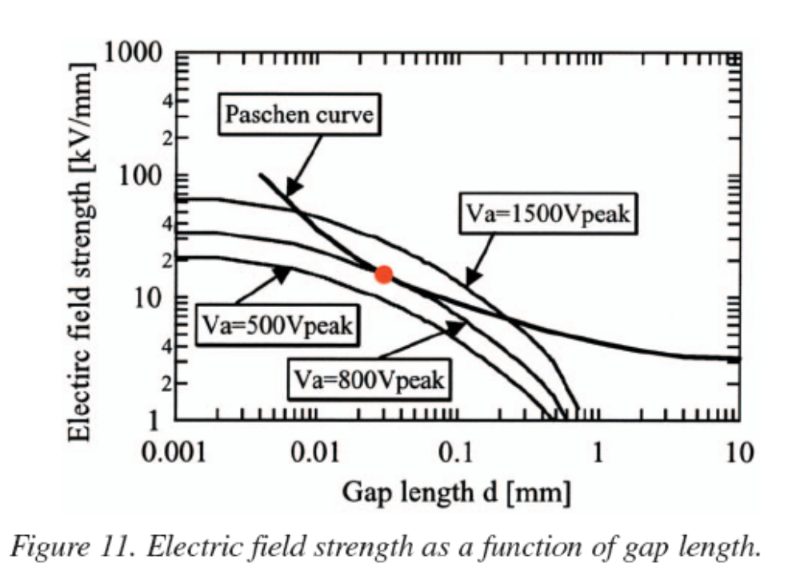
Non-destructive test methods in HV engineering
Point of inception

Slide 24
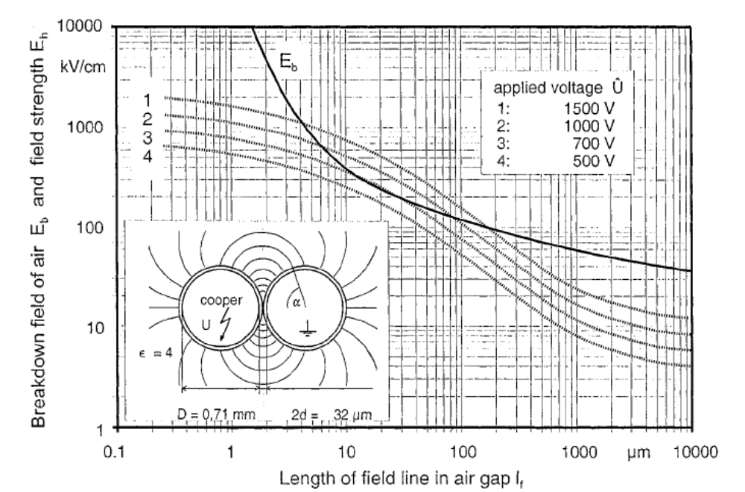
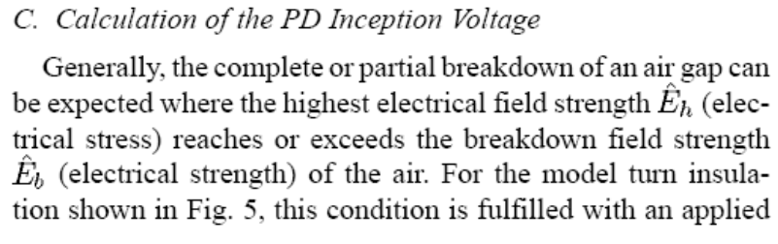
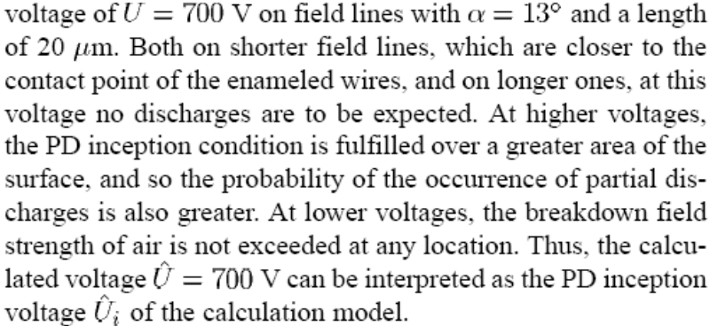
Non-destructive test methods in HV engineering

Slide 25
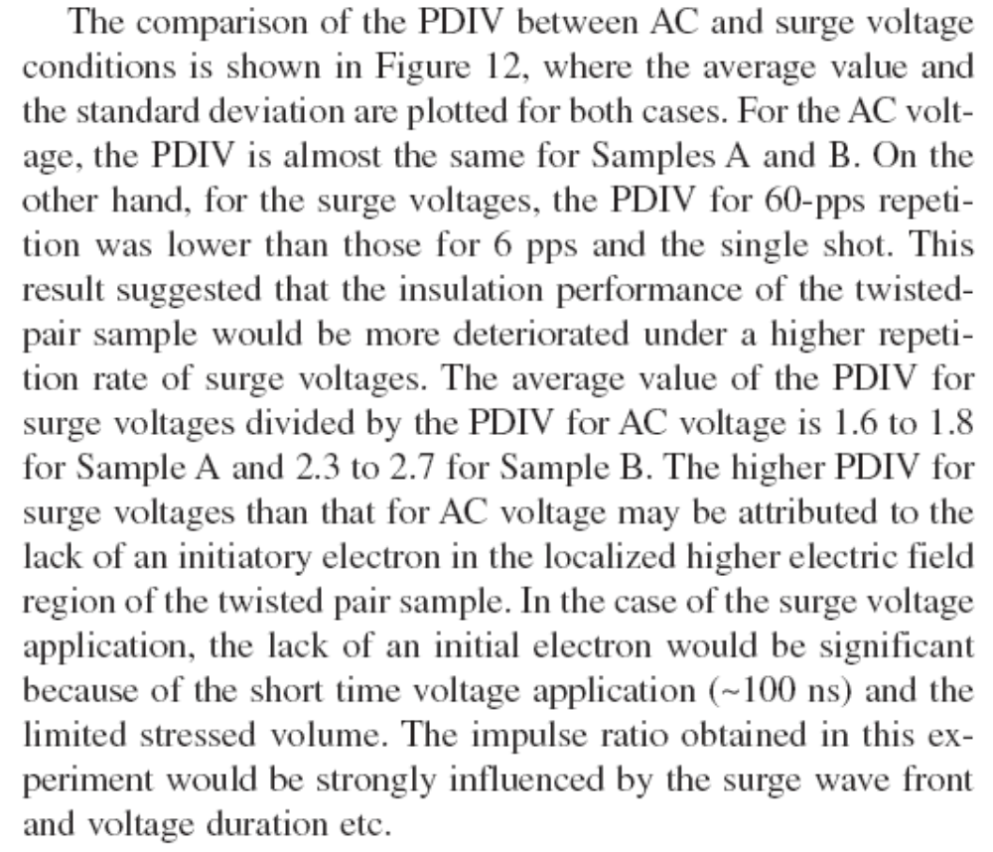
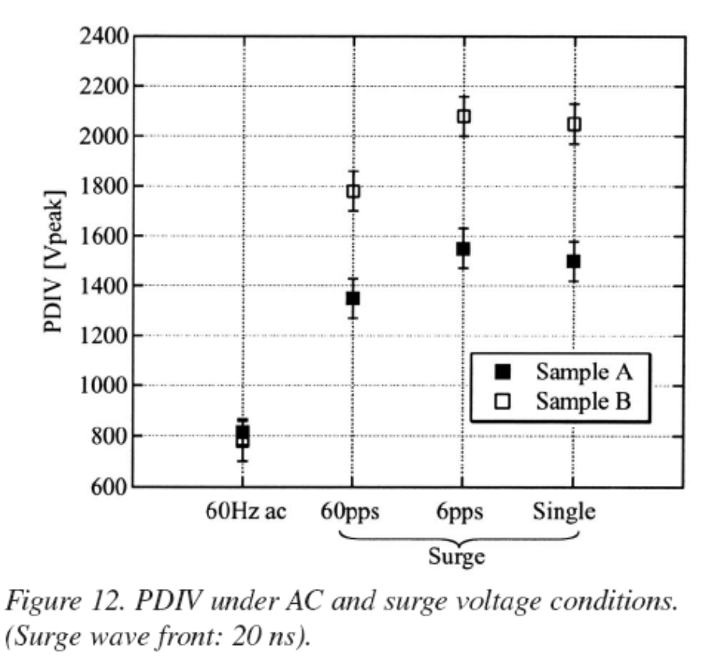
Non-destructive test methods in HV engineering
Initiating electron !!!!!!

Slide 26
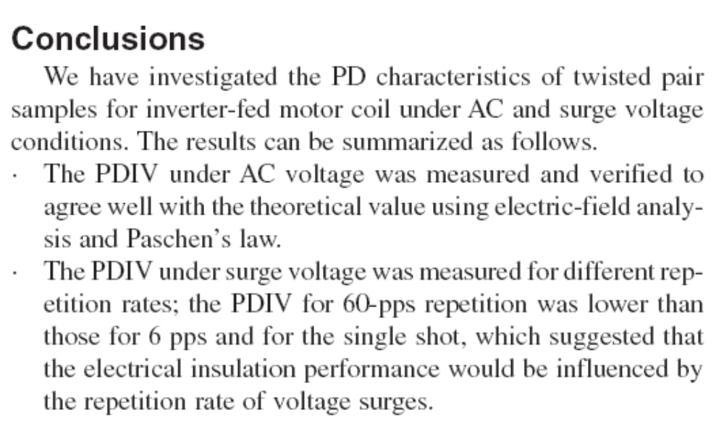
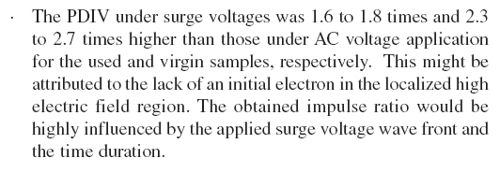
Non-destructive test methods in HV engineering

Slide 27
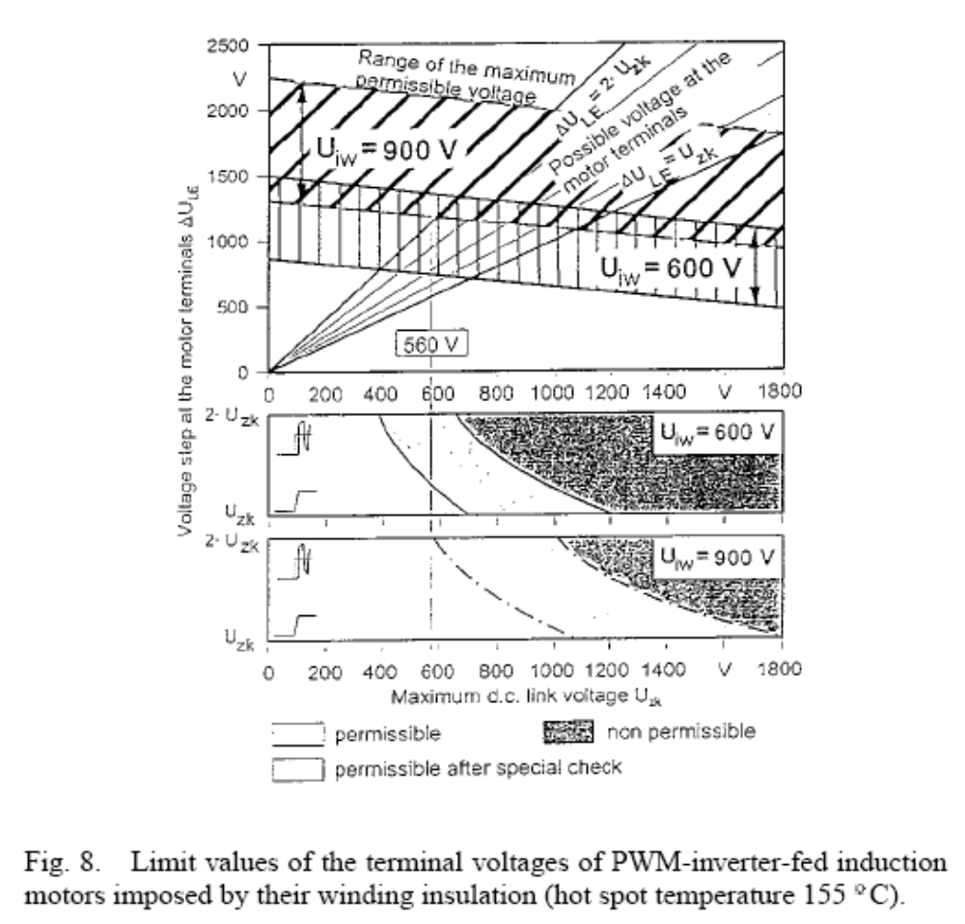
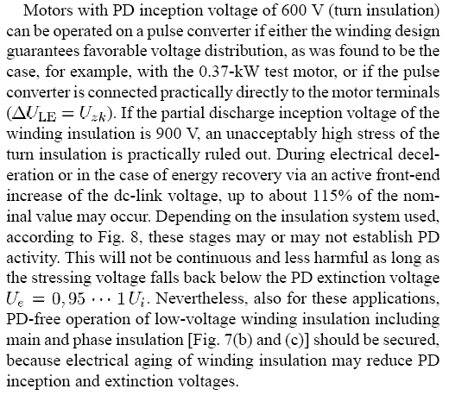
Non-destructive test methods in HV engineering

